Slide 2
Rural Areas in a Highly Industrialised Country
Hartmut Berndt
German LEADER Association (BAG LAG)

Slide 3
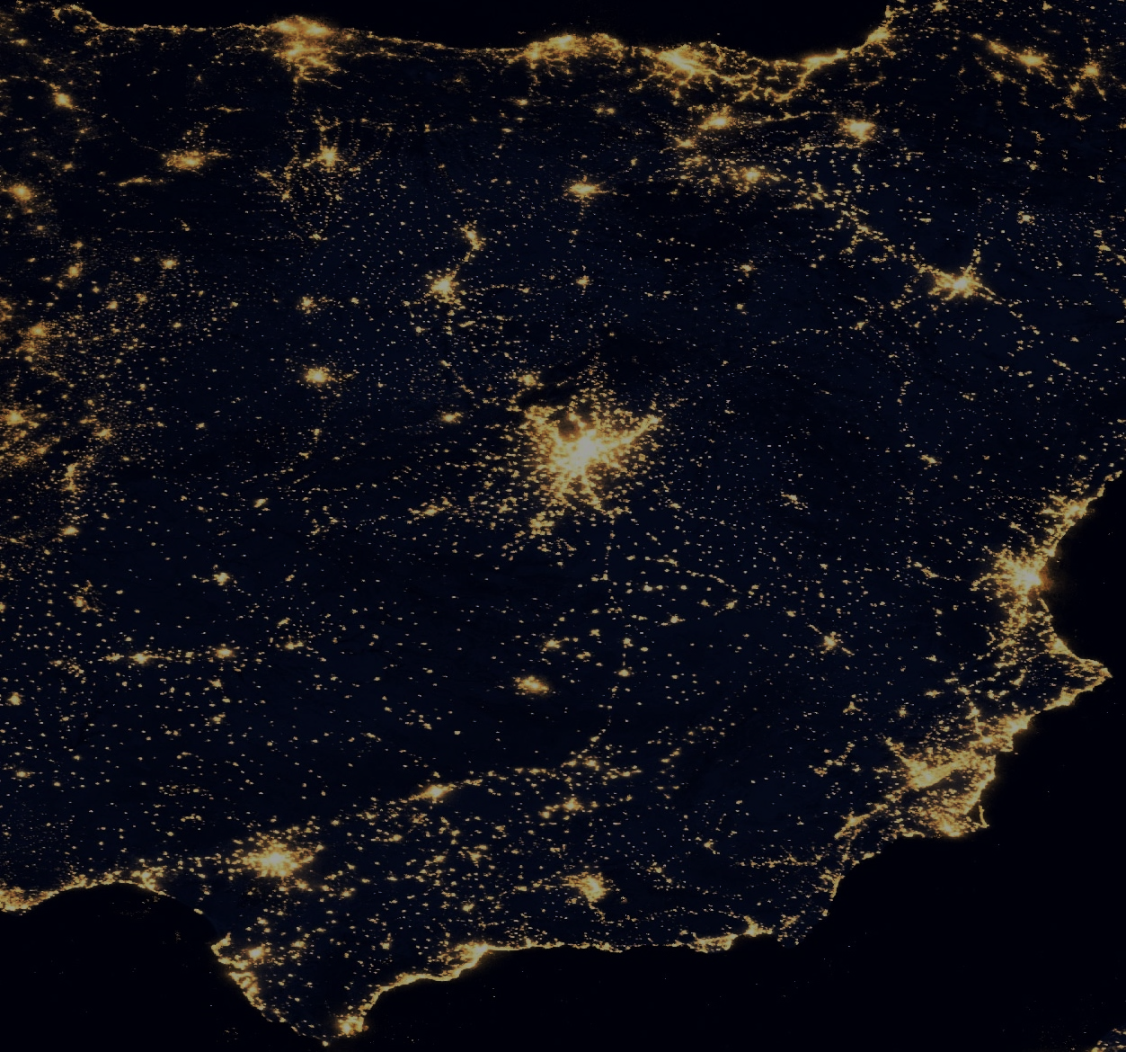
Rural Areas in Germany?
High population density in Germany
Many metropolises
Not centralised
Accessibility of
Schools
Medical care
Shopping facilities
Cultural institutions

Slide 4
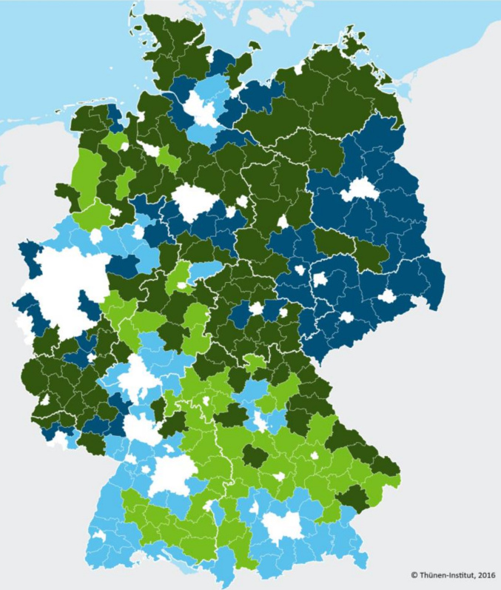
Definition of Rural Areas
Thünen Institute for rural areas defines 2 dimensions*:
Rurality
Socio-economic Conditions
strong
Very rural
“… socio-economic problems are not per se connected to rurality”
weak
weak
Rurality and socio-economic conditions are multifactorial
Fairly rural
strong
Urban
57 % of the German population live in rural areas, which sum up for 91 % of the total area
* Küpper P (2016) Abgrenzung und Typisierung ländlicher Räume. Thünen Working Paper 68

Slide 5
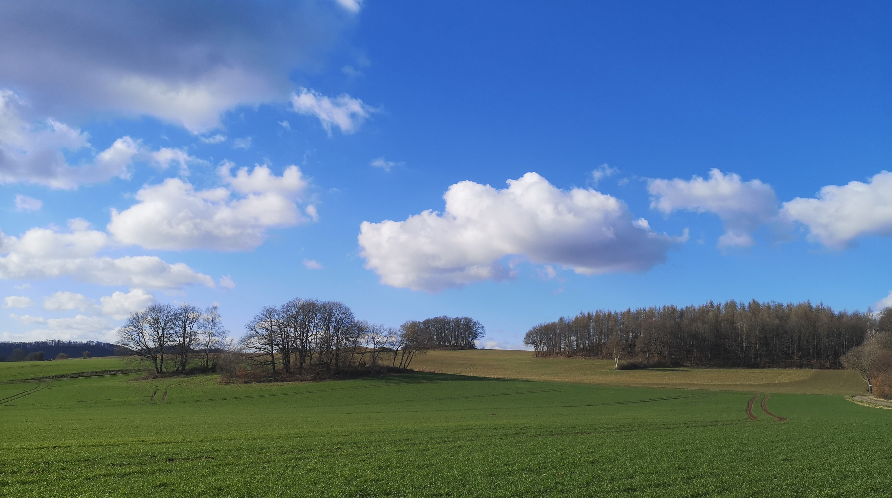
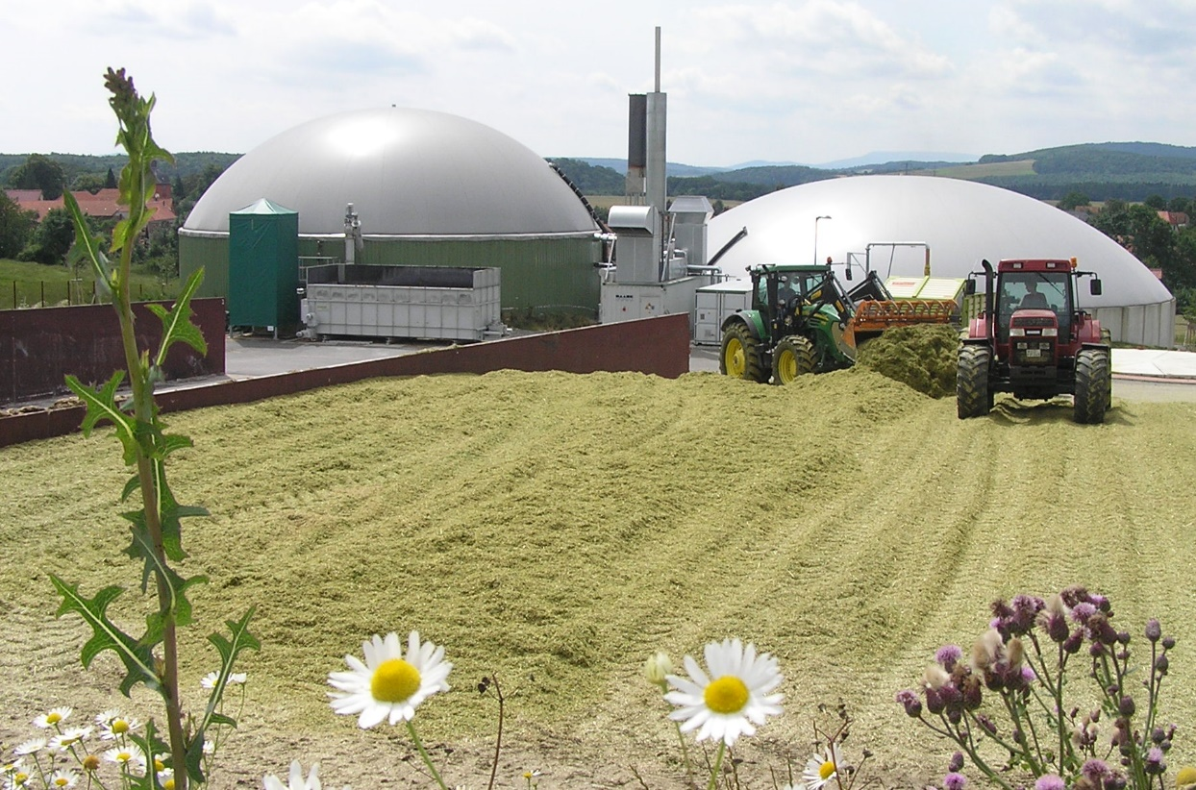
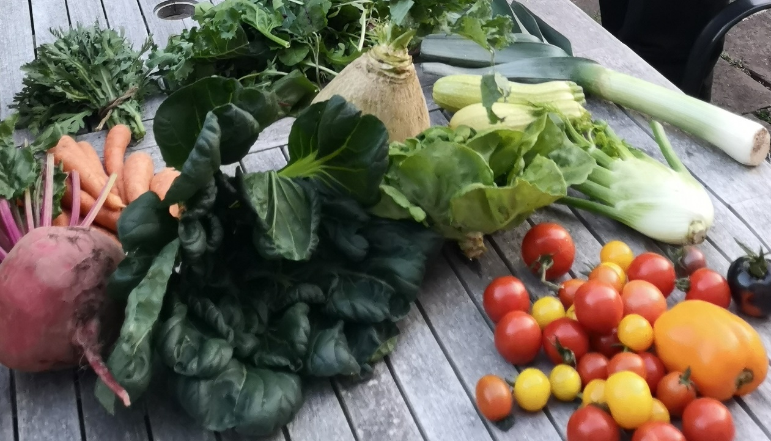
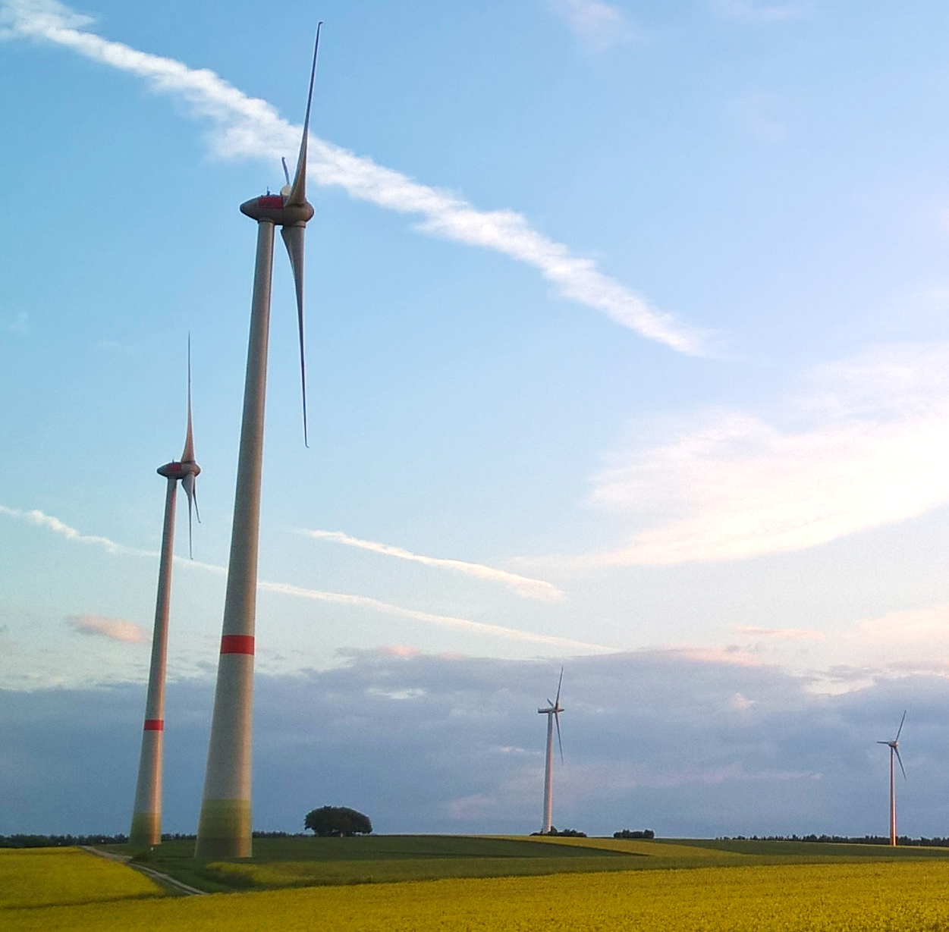
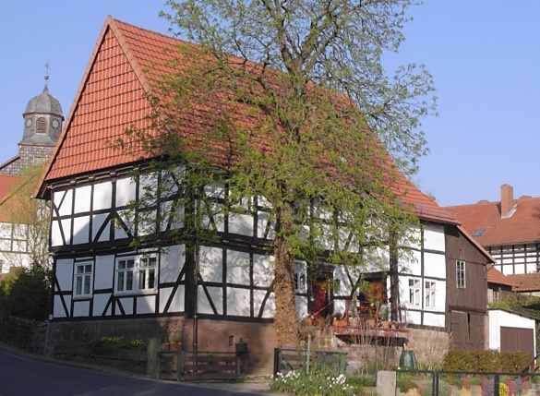
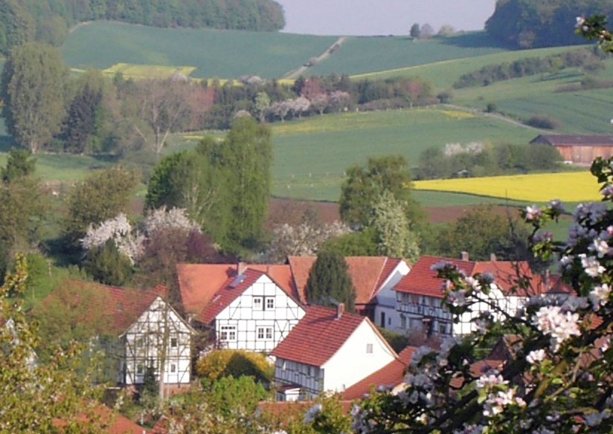
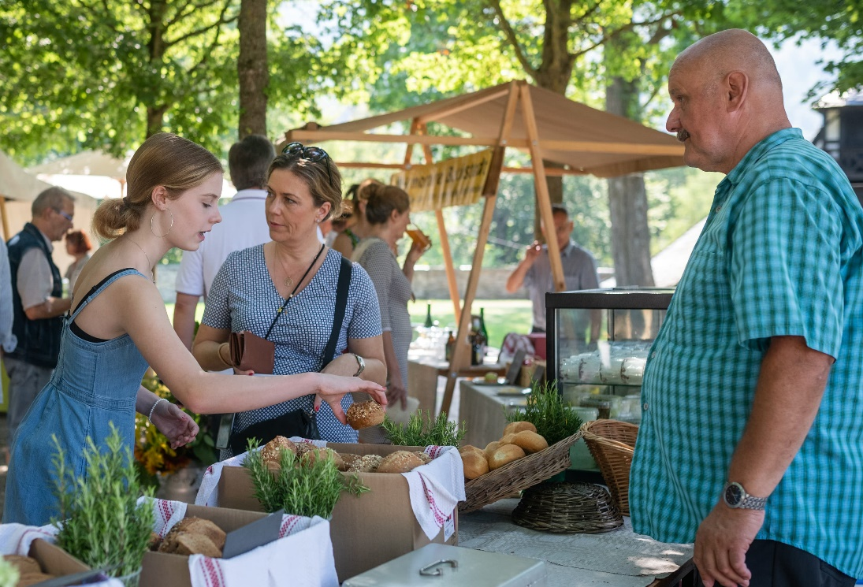
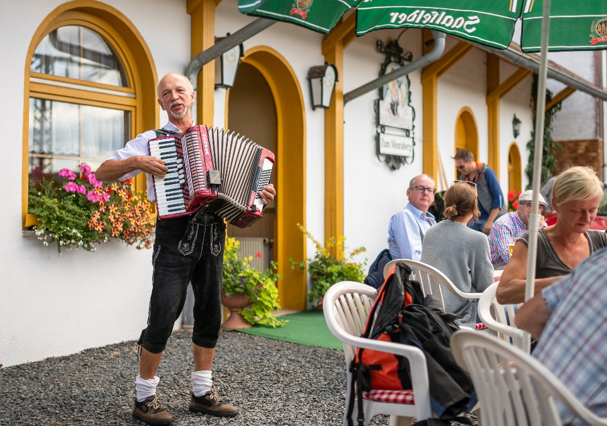
Rural areas are very different, but they all have special potentials
Each territory must find its own identity and be aware of its specific characteristics
Rural areas have the potential to develop into viable living spaces

Slide 6
It is our task to ensure conditions under which rural areas can use their potential for a viable and sustainable development.

