Slide 2
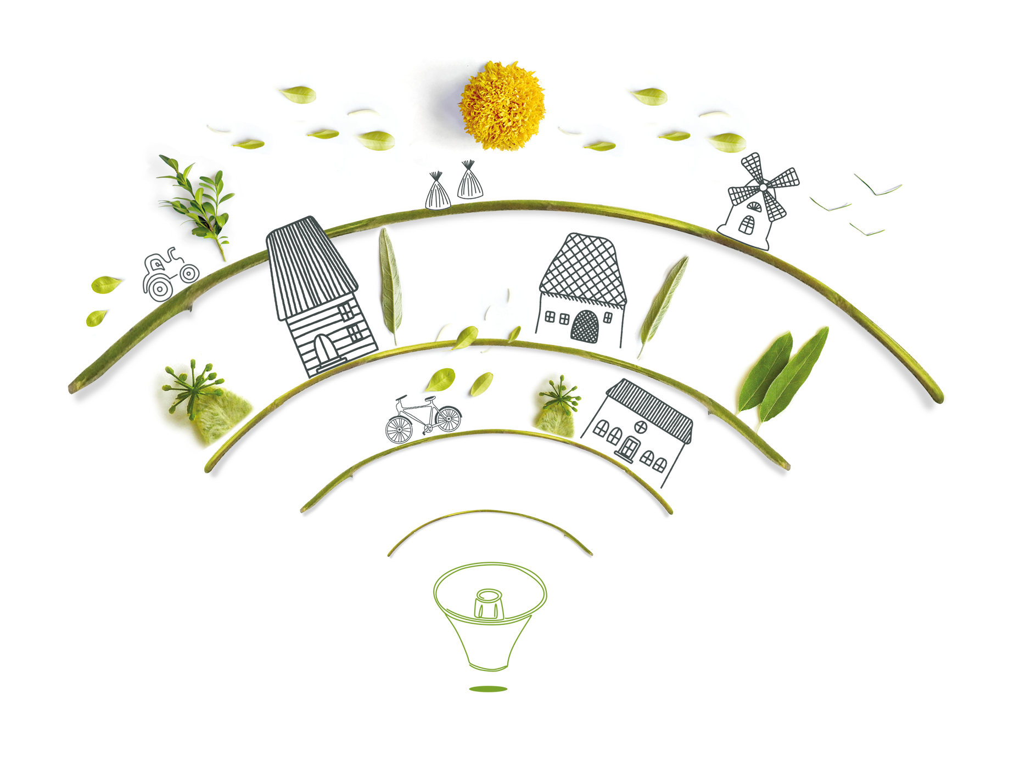
The Rural Pact
& Rural action plan
Alexia ROUBY
DIRECTORATE GENERAL FOR AGRICULTURE AND RURAL DEVELOPMENT,
EUROPEAN COMMISSION

Slide 3
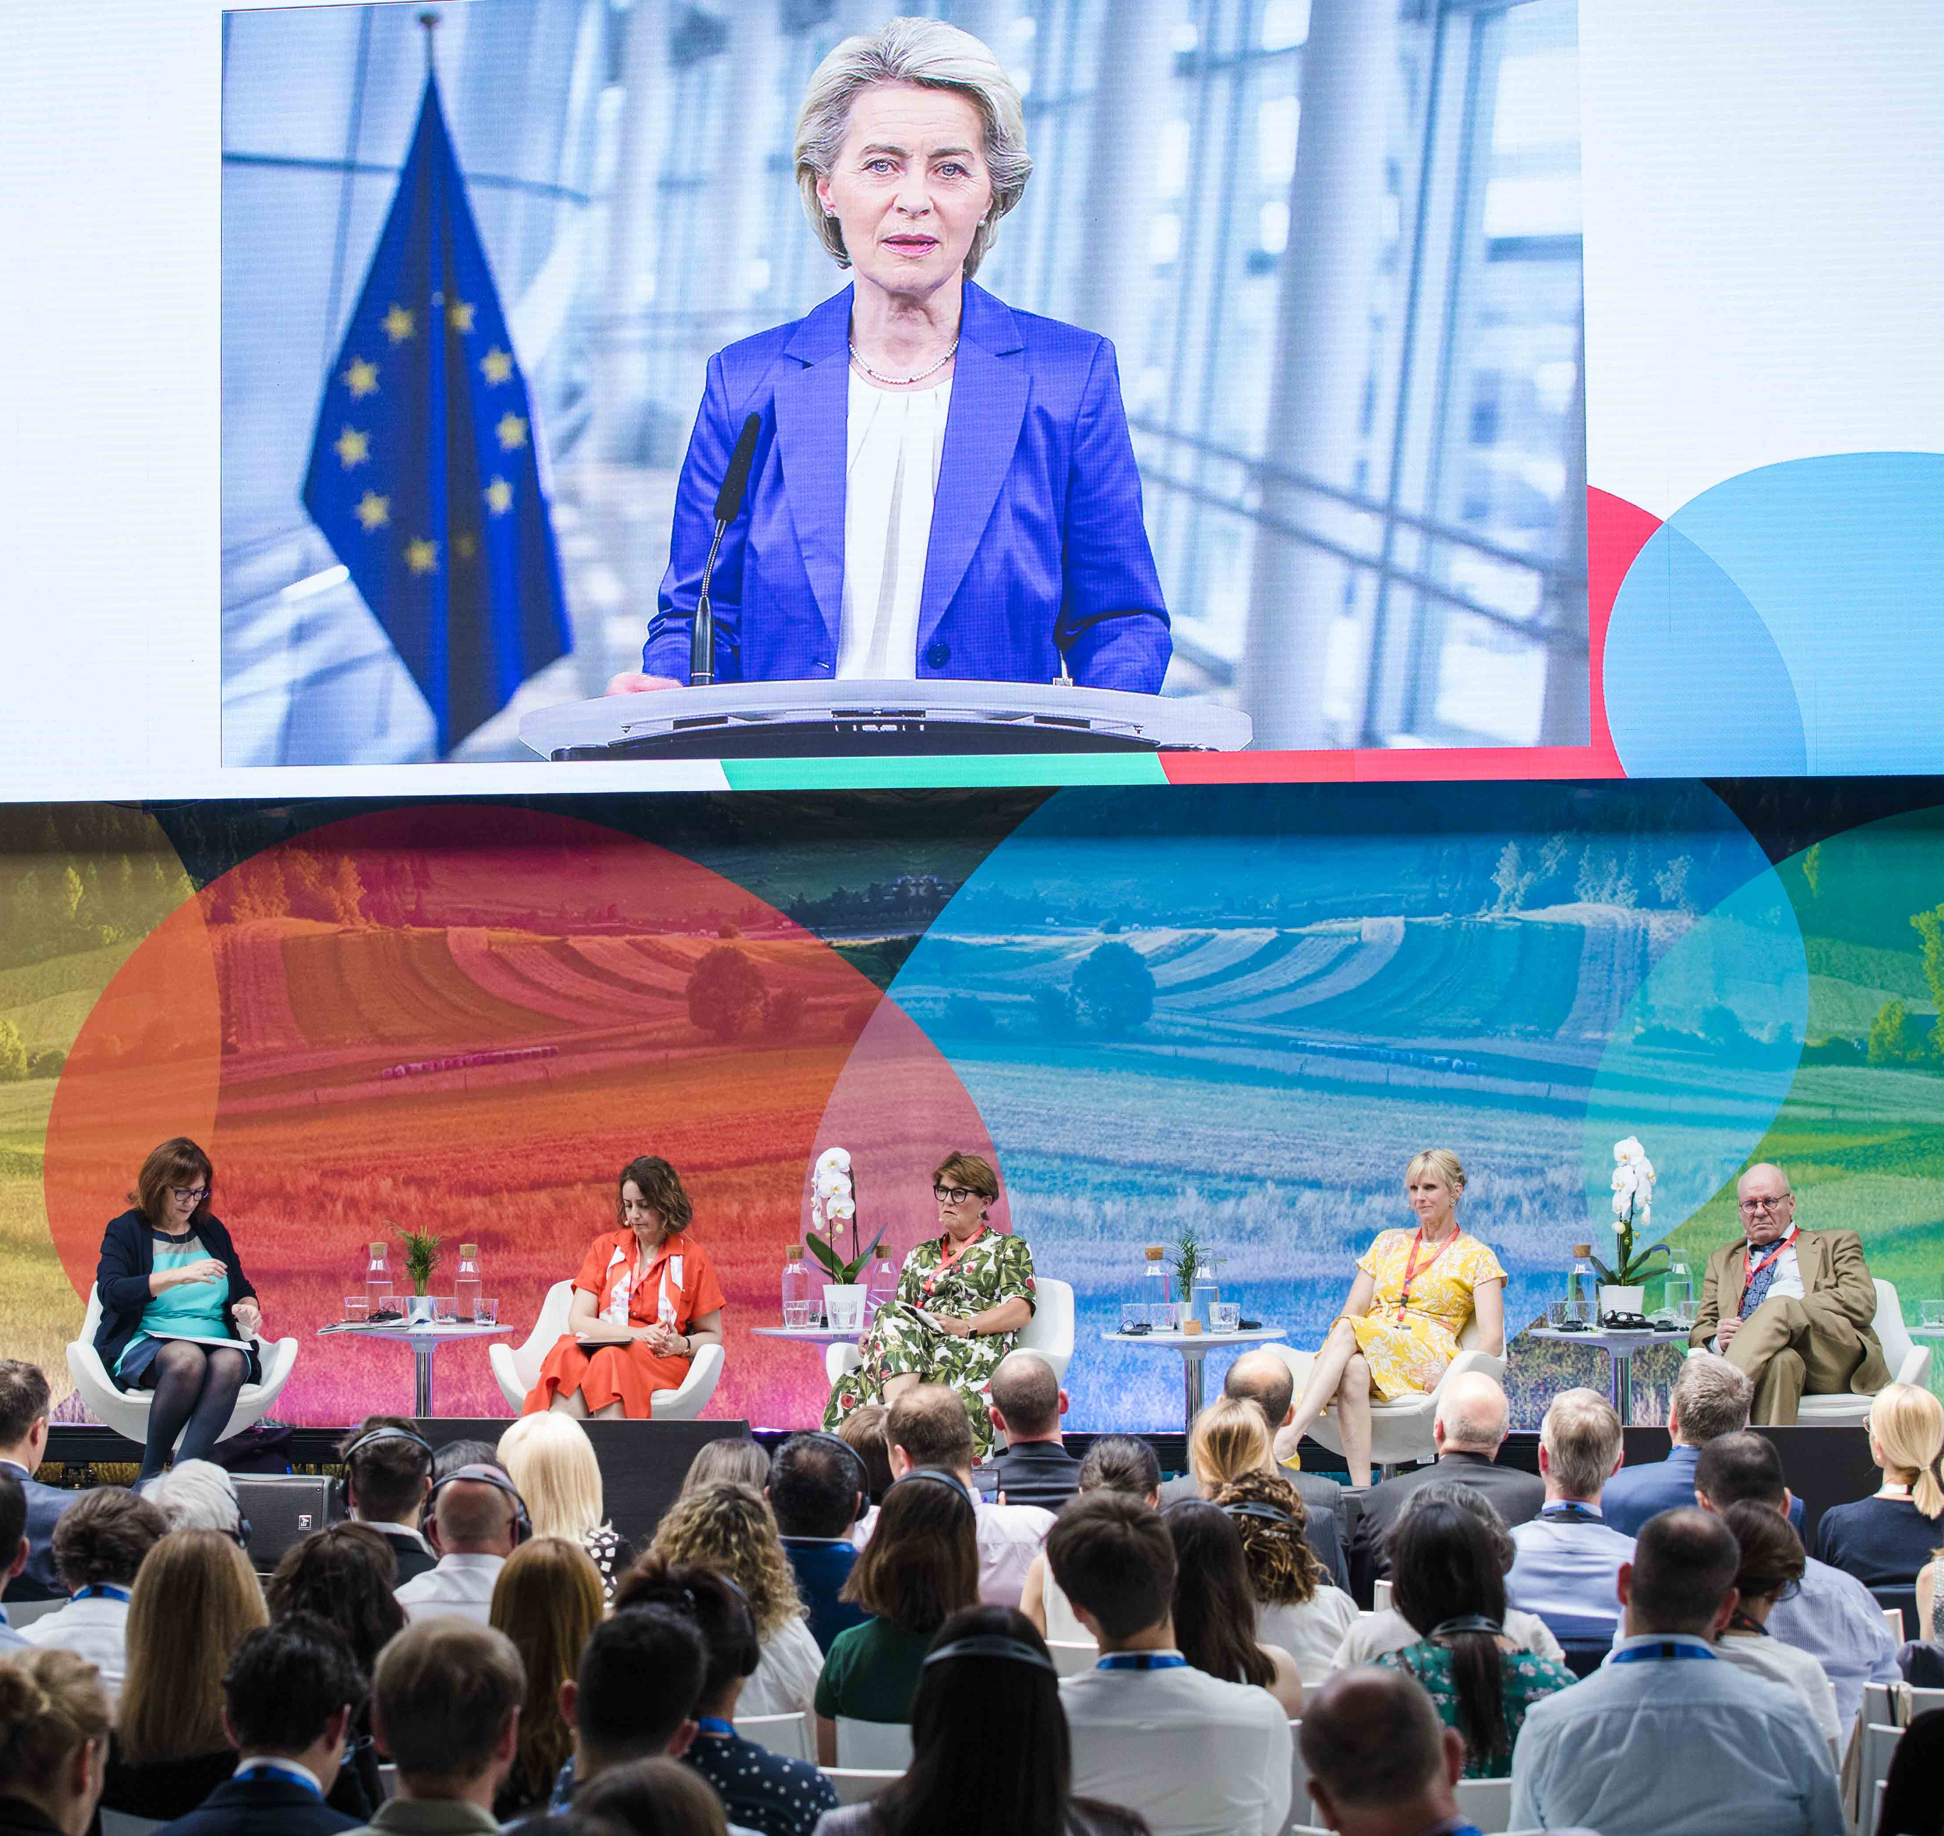
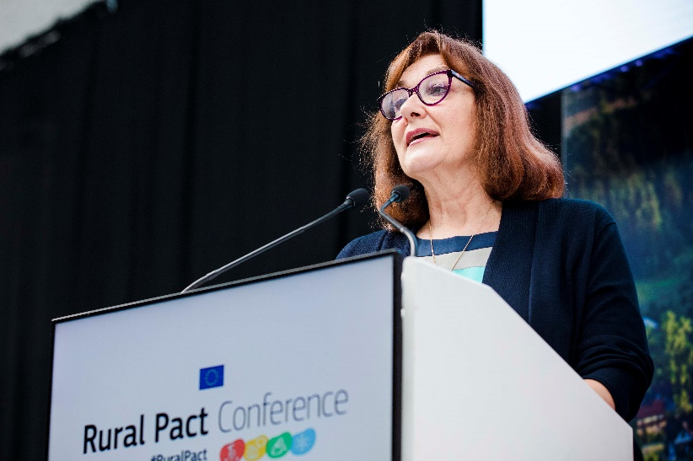
“Rural communities are a cornerstone of Europe’s resilience and independence. And when life in our countryside flourishes, so does our European way of life.”
President Von der Leyen – June 2022

Slide 4
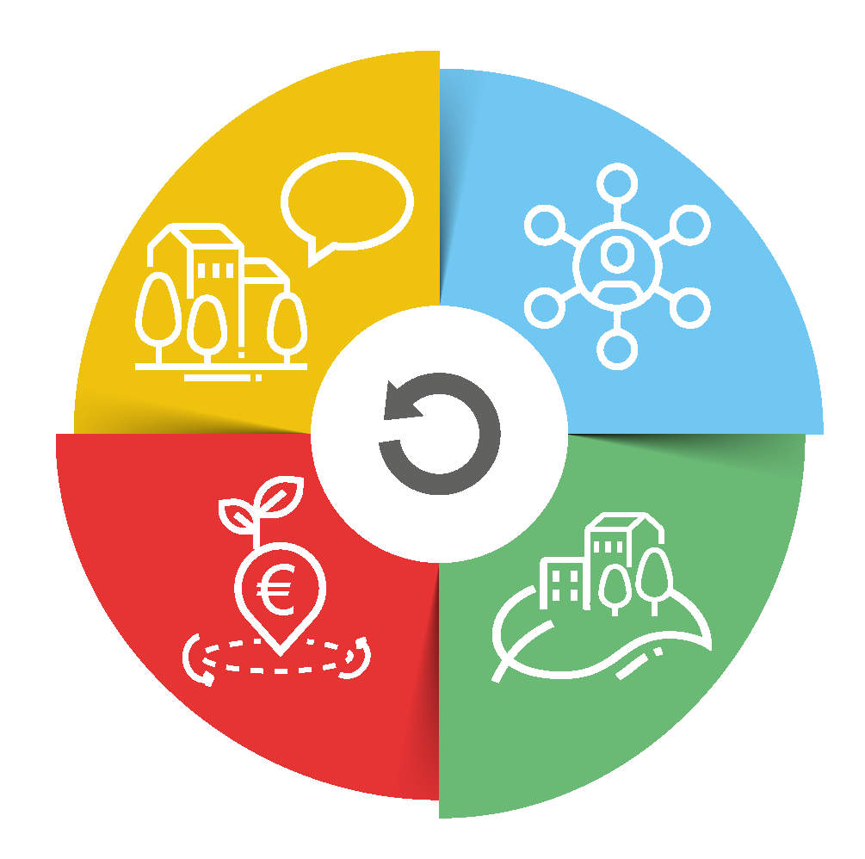
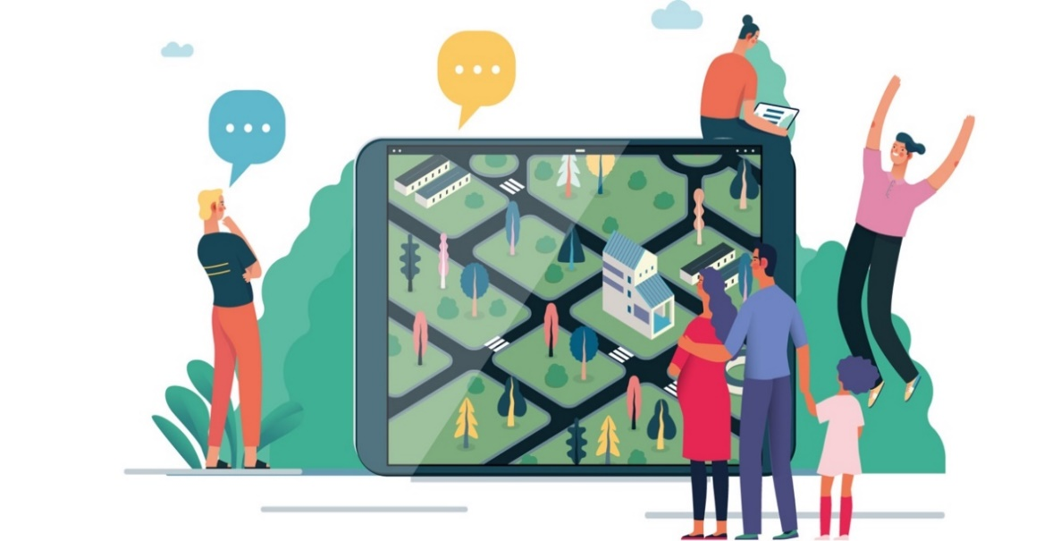
The vision and its shared goals
Shared goals for 2040
Stronger
Empowered communities
Access to services
Social innovation
Connected
Digital connectivity
Transport links and new mobilities
Rural action plan (EC)
+
Rural Pact (others)
Prosperous
Diversification of economic activities
Sustainable food production
Resilient
Resilience to climate change
Environmental resilience
Social resilience

Slide 5
The Rural action plan
24 thematic actions
9 flagships + 15 accompanying actions
Rural revitalisation platform
Research and innovation for rural communities
Stronger
Connected
Sustainable multimodal mobility best practices for rural areas
Rural digital futures
Support rural municipalities in energy transition and fighting climate change
Cross-department coordination
Prosperous
Resilient
Climate action in peatland through carbon farming
EU mission: A soil deal for Europe
Social resilience and Women in rural areas
Entrepreneurship and social economy in rural areas.

Slide 6
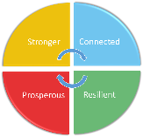
The Rural action plan
24 thematic actions
Support rural municipalities in energy transition and fighting climate change
Rural energy communities advisory hub
Sustainable multimodal mobility best practices for rural areas
SMARTA 3 Networking for municipalities
Rural revitalisation platform
ENRD Thematic group
IT development to start
Entrepreneurship and social economy in rural areas.
Clusters of social and ecologic innovation (rural focus) report published – study by RTD
Euroclusters call
European cluster collaboration platform
Transition pathway for proximity and social economy (Q3 2022)
Climate action in peatland /carbon farming
Comm “Sustainable C cycles”
3 LIFE projects
Just transition fund
CAP assessments
Certif. C removals
Urban mobility framework published
Research and innovation for rural communities
Horizon 2021-2022 launched (67M€)
Startup village forum
EIP-AGRI, RIS3
Horizon 2023-2024
Rural Digital Futures
Horizon + DEP WP published
EDIH
Digital skills and jobs platform
Pilots on digital education for children in remote areas
5G for smart com.
Rural digital index
EU mission: A soil deal for Europe
Calls published
Education and youth
Study on rural young people access to ERASMUS and ESCP
Social resilience and Women in rural areas
European care strategy (2022)

Slide 7
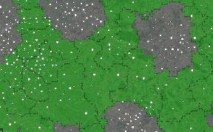
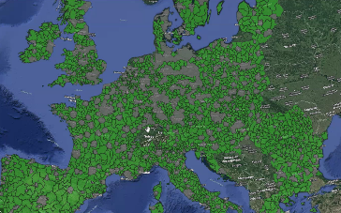
The Rural action plan
6 Horizontal actions
@one Rural vision website
(including rural revitalisation platform)
Rural observatory
Collecting and making rural data available
Improving statistics
Transmission of georeferenced data by MS
First dashboards expected for end of 2022
Functional rural areas
First methodology developed by JRC and REGIO
Experimental datasets on healthcare and education facilities published
Toolkit on EU funding
Administrative agreement with JRC
Tendering in progress for a Rural pact support office (events, working groups, comm. etc.)
Facilitation of the Rural Pact
Delivery 2023
Start in 2023
Rural proofing
Kick-off meeting 23 June
Pilot phase (2022)
Session on “evidence for policy” at Rural Pact conference
ENRD thematic group on Rural proofing at national and regional levels
Improving the statistics we have on rural areas
Statistics on population: new regulation in discussion
Applying the concept of functional areas to rural
Rural pact community launch (Dec 2021)
Rural pact conference (Jun 2022)
Updated better regulation guidelines (Territorial impact assessment and rural proofing)
Thinking through a rural lens
Practitioner oriented tool on how to use and combine EU funding opportunities

Slide 8
The Rural Pact
Conclusions from the Rural Pact conference and next steps

Slide 9
The Rural Pact Communication
Participatory Process
Linking with CoR and Networks
Member States
The Rural Pact
a framework for interaction between all levels of governance and stakeholders on rural development
EU
Regions
Stakeholders

Slide 10
Rural Pact
Final proposal
Launch & Development
Community Launched in December 2021
(1070 members)
Consultation of Rural Pact community
(May 2022)
Reflection with institutions and stakeholders (prep group)
+ letters to Member States (April)

Slide 11
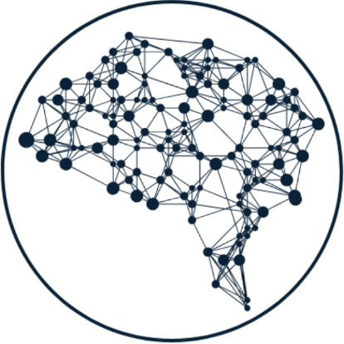
Click here to add body
Rural Pact objectives
Amplifying
rural voices
Networking, collaboration & mutual learning
Encouraging and monitoring action

Slide 12
Click here to add body
Rural Pact participants
Public authorities
Civil society
Businesses
Individuals
Academic and R&I bodies
Participating in the pact = committing to act for one or more of its objectives

Slide 13
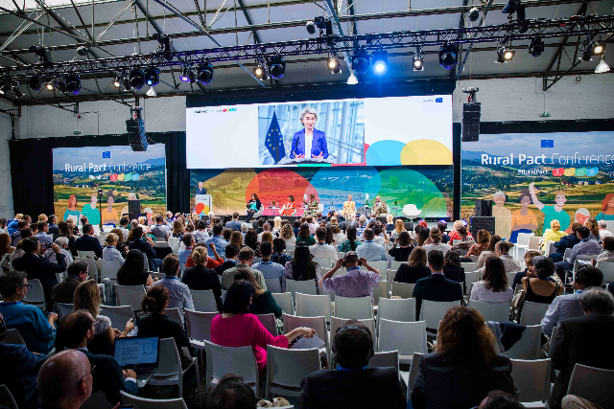
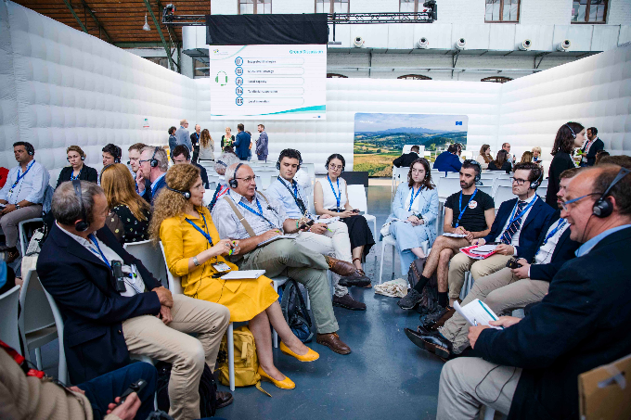
Click here to add body
The Rural Pact conference
475 on-site
300+ on-line
46% rural people
20 Sessions, 15 participatory parallels
Presentations, Recordings, Conclusions
Rural areas on top of agenda
Networking and mutual exchange
Ideas for action
Commitments
Rural Pact endorsed

Slide 14
Click here to add body
Commitments = specific actions
“Introducing car sharing with cars of the municipality and companies by the end of 2022.”
“I commit to engage in setting up an energy community in my 12 municipalities territory.”
I come from:

Slide 15
Click here to add body
European Commission facilitation
Define governance structures, Coordination group
Create collaboration platform (website)
Set-up Rural Pact support office
Networking events
Keep up the discussion with the community
Dialogue with institutions and Member States

Slide 16
Click here to add body
How can you take part and benefit?
Rural action plan
Apply to EU level calls for projects
Take part in new broader networking activities (energy, mobility etc.)
Rural Pact
Use the Rural vision momentum to renew dialogue with governments
Collaborate and network on subjects brought up by you, with new actors
Use new knowledge made available on all aspects
Get inspiration for your action on the ground

Slide 17
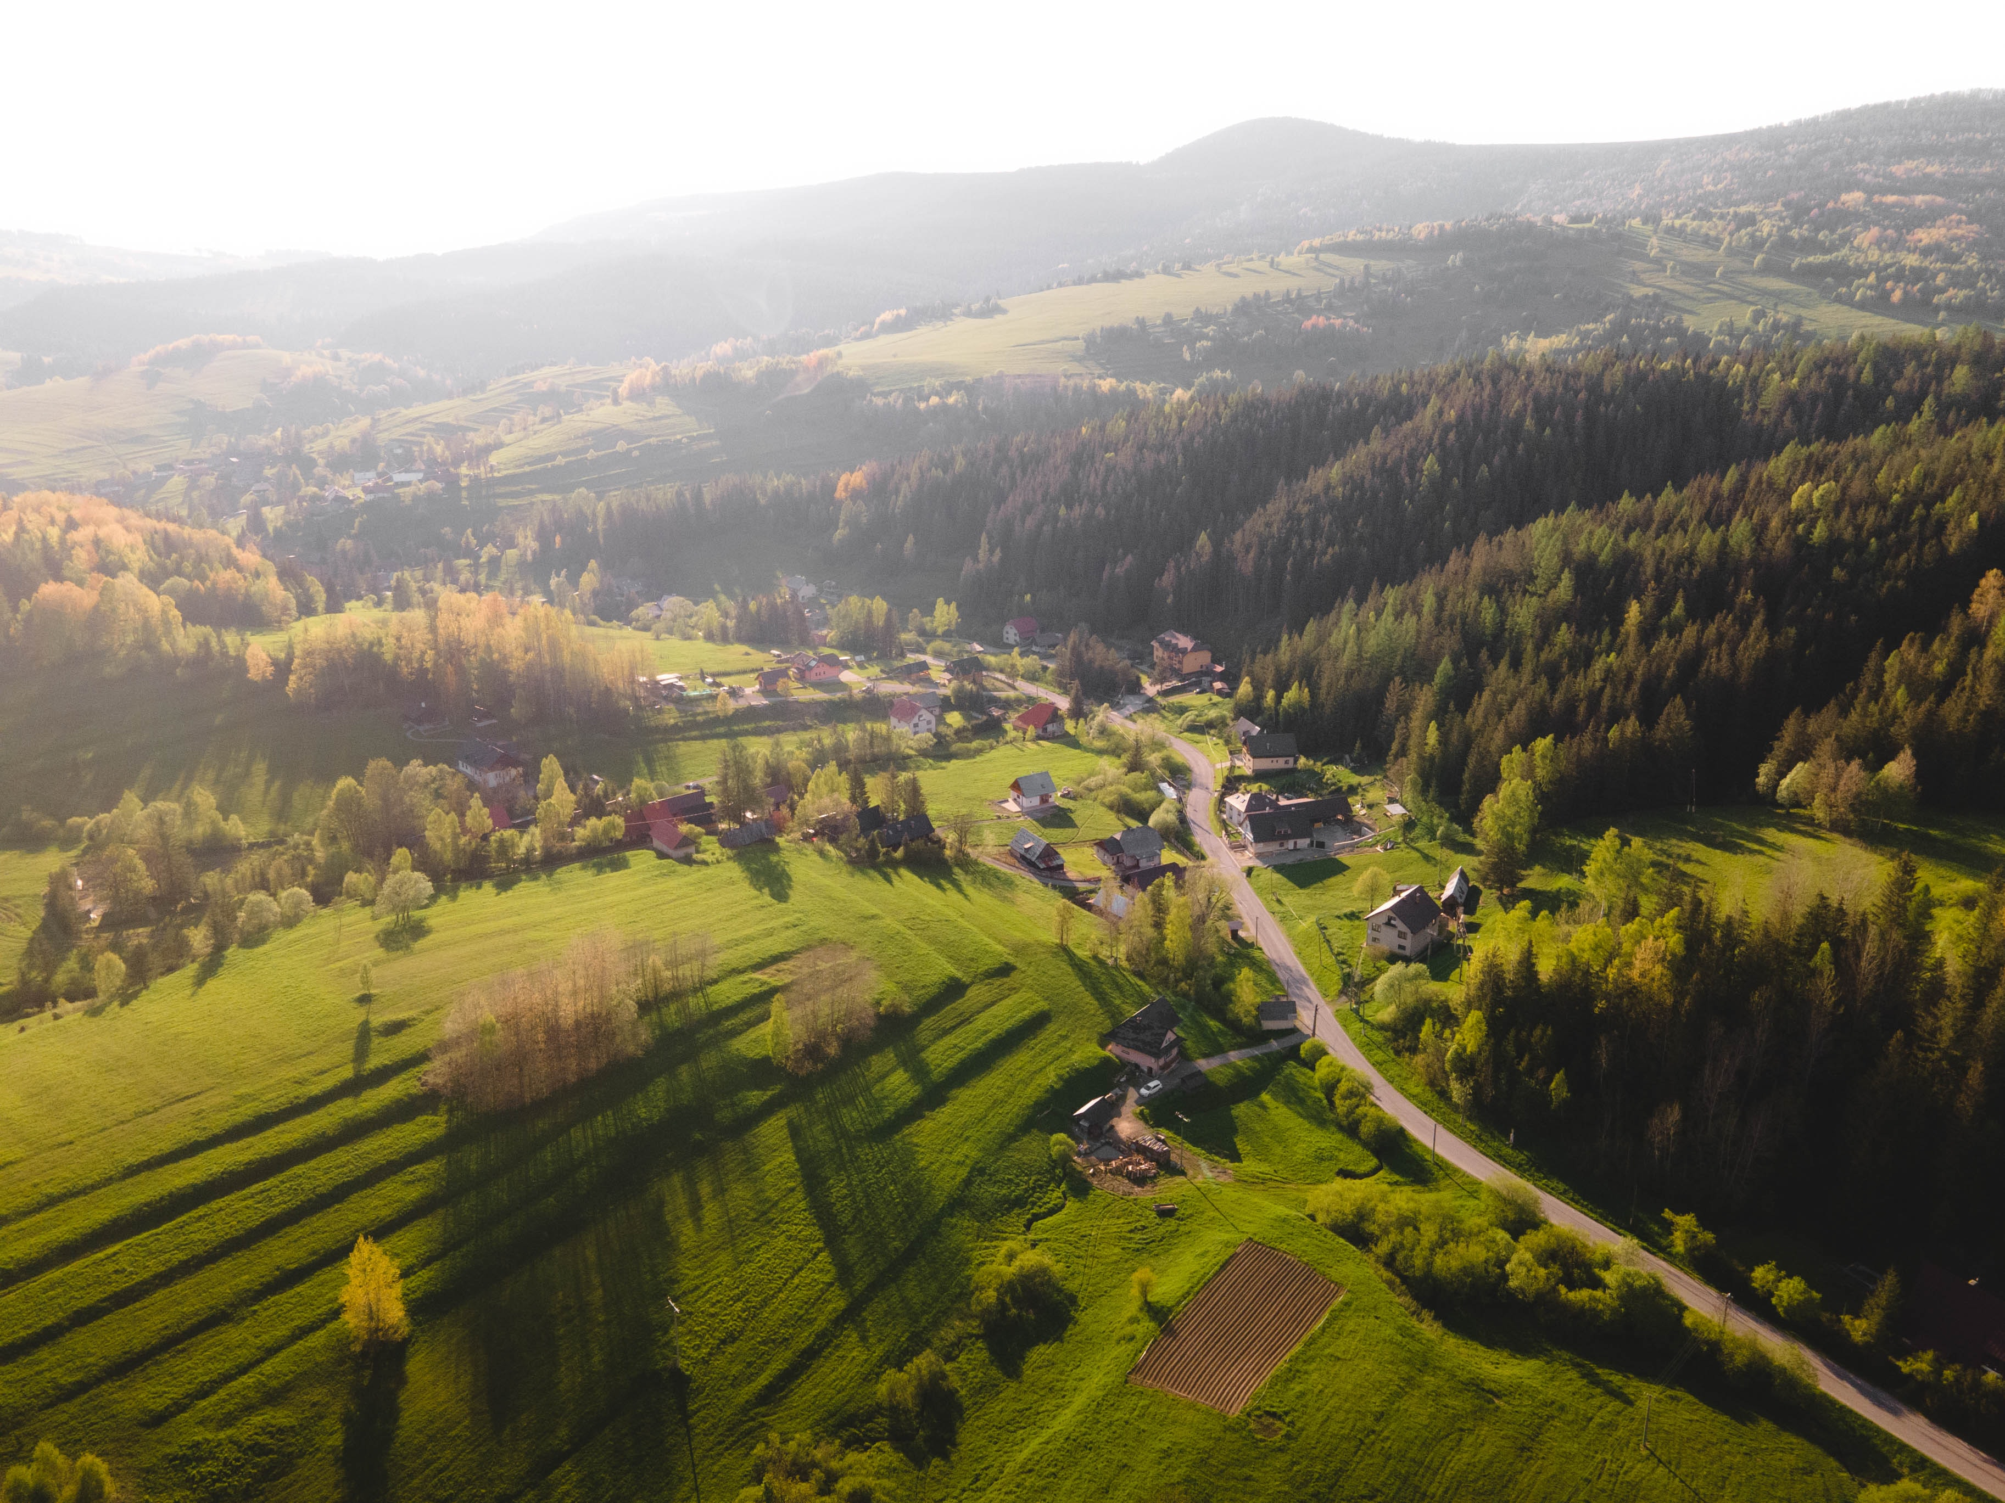
Thank you
Read the Rural Pact
Join the Rural Pact community & Tell us how you want to contribute!

