Slide 2
Rural Peoples Declaration and Manifesto
Marion Eckardt, Aris Adlers, Tom Jones
ELARD, PREPARE, ERCA

Slide 3
Manifesto and Declaration – what is what?
Manifesto
What is the manifesto?
“a written statement declaring publicly the intentions, motives, or views of its issuer”
Longer and more detailed than declaration
Manifesto from 2019 includes 29 points about different themes (like education, youth, leadership, quality of life etc.), policies (EU enlargement and neighbourhood policies, LEADER & CLLD etc.) as well as processes (migration, rural-urban cooperation, search for decentralised solutions etc.)
First manifesto created 2015, new one in Venhorst 2017. The Manifesto from 2019 was very thoroughly prepared took into account material collected from 10 national rural parliaments, other reports from ERP partners, and surveys/Social media campaigns organized by the Europe for Citizens finance ROAD project over 2018-19
When will the 2022 manifesto be ready?
Our manifesto is getting updated via survey – will not be ready today. Also the input from 5th gathering will be included (workshops, workdcafé, studytrips a.s.o.) will be included
We will send drafts to our partners and youth representatives during autumn and make a digital meeting to decide upon it.
Basic changes so far: received 142 suggestions and comments from 29 countries for all of the points and horizontal.
Use the manifesto for advocacy
all partners are welcome to use it! We want to spread it. Any of the partners are entitled to bring forward our message!
SG will use it in policywork in Brussels - probably in January, together with young partners, also in any other occasion we see fit.
Notes:
Main suggestions and comments regarding these topics (to give short look into the themes with/without some examples): - a lot references on the new circumstances (challenges and opportunities for rural) we live in – C19 and Russian war against Ukraine, - mental health, - digitalisation, - access to housing, moving to rural for some, growing repopulation for other (also co-existing), - involvement of local stakeholders, self-governance, local councils. Village pact. - trust and confidence in politics and from politicians, need for support from national governments, integration of rural dwellers in political decisions. Actions that should be recognized and taken into account by those holding the power, - practical support to rural (finances and human resources not just words), - women in decision making, - unique rural lifestyle and service provision, not copied or compared to urban, - food resilience, food systems, food insecurity, - Brexit, - mandatory support for CLLD, - struggle of EU candidate states (move it towards the possibility for them to meet the criteria), - of course other as well. 😊
The draft Manifesto November 2019 was produced from materials collected in 10 national Rural Parliaments, other event reports coming from European Rural Parliament (ERP) partners, and surveys/social media campaigns organised by the Europe for Citizens financed ROAD-project over 2018-19. The draft was discussed in 3 webinars, reformulated and language checked. The final version from January 2020 takes also into account messages from 22 workshops and six field visits undertaken at the 4th ERP in Candás, Asturias, Spain 6-9 November 2019. The following changes have been made to the Venhorst Manifesto from 2017: - A Preamble including the core message, the vision and the commitment is added. - Specific references to geographical, ethnical or specific rural categories have been removed and dealt with in this background paper and the Manifesto has been restructured. - Recent developments in rural policies have been taken into account.

Slide 4
Manifesto and Declaration – what is what?
Declaration
What is the declaration?
“a formal or explicit statement or announcement”
Shorter than the manifesto, 1-2 pages.
More changes, more different each time. More affected from the signs of the time.
When will the 2022 declaration be ready?
Its ready! We will sign it in a couple of minutes!
SG have made survey on the declaration during last months. We have had repeadetly steeringgroupmeetings on the subject. Before this gathering but also during this gathering in order to make input from what we have heard during the meeting. We finalized it last night.
Use the declaration for advocacy
all partners are welcome to use it! We want to spread it. Any of the partners are entitled to bring forward our message!
SG will use it in policywork in Brussels - probably in January, together with young partners, also in any other occasion we see fit.

Slide 5
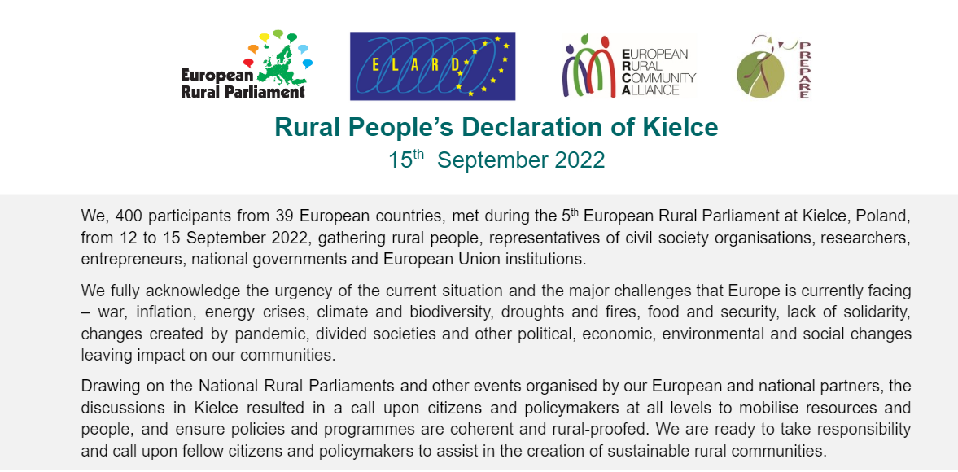

Slide 6
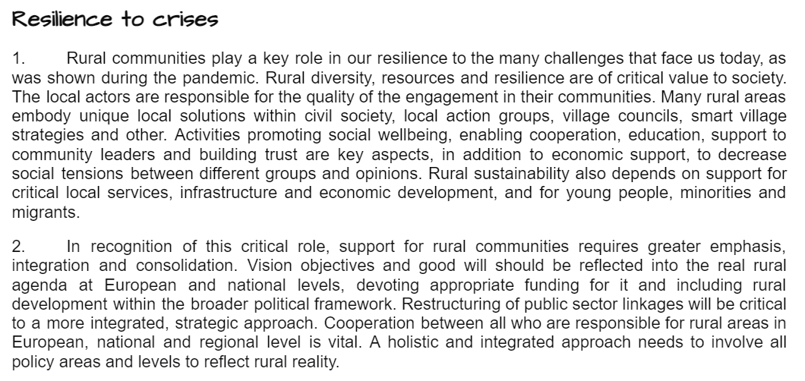

Slide 8
